Slide 1
NeRF: Neural Radiance Fields
Zheng Dihan
2022/02/28

Slide 2
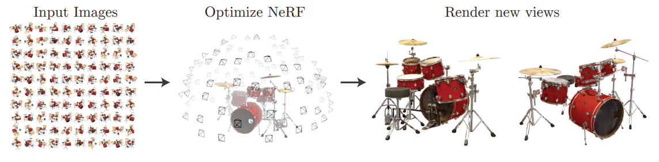
What is NeRF
A method that optimizes a continuous 5D neural radiance field representation (volume density and view-dependent color at any continuous location) of a scene from a set of input images.

Slide 3

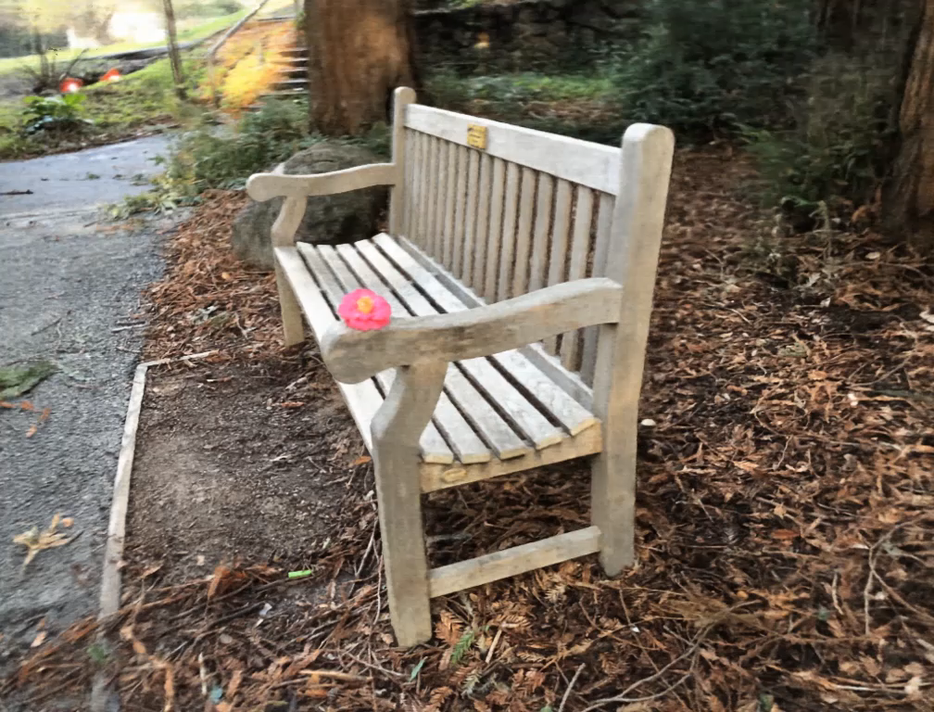
Scenes representation with NeRF

Slide 4
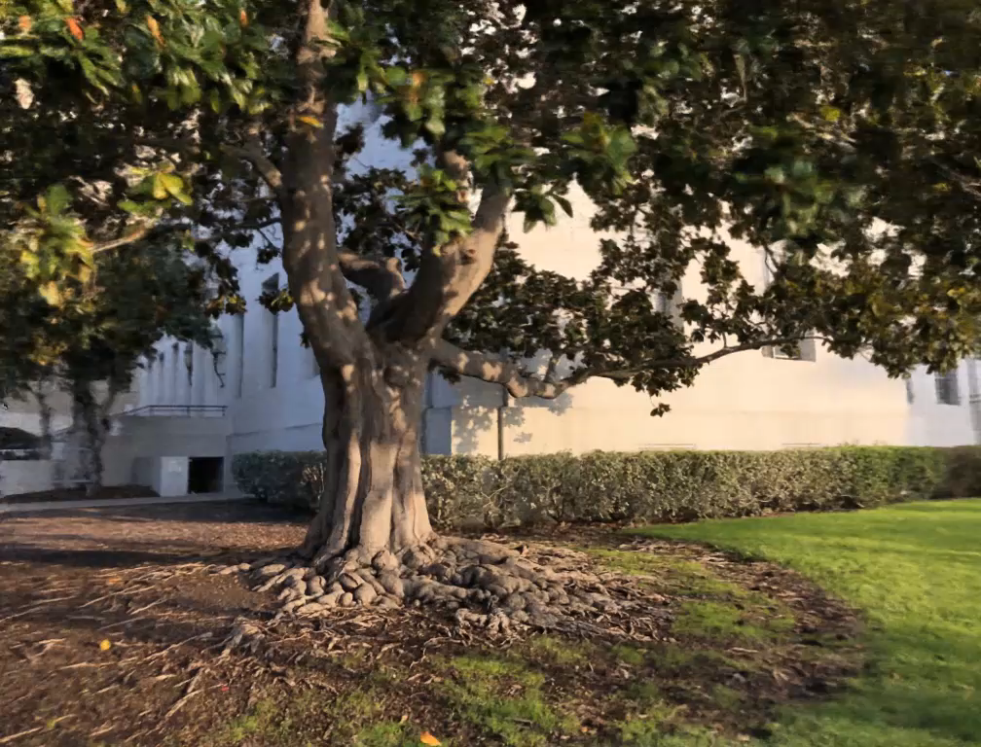
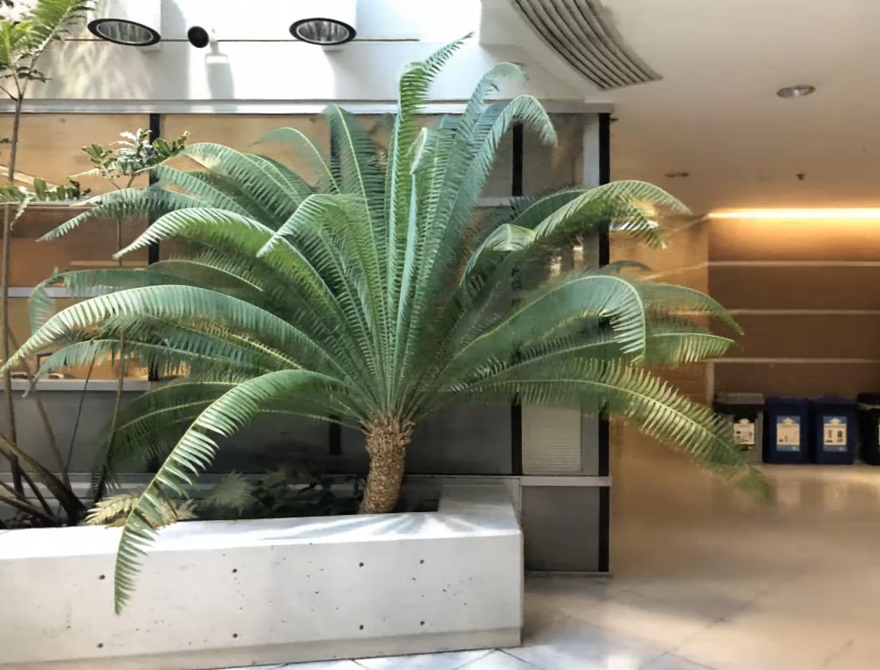
Scenes representation with NeRF

Slide 5
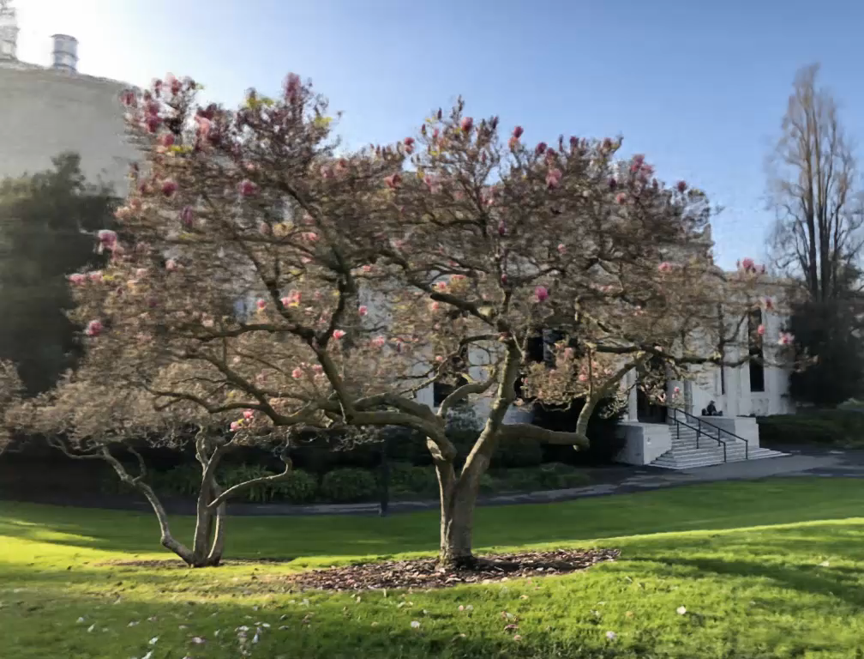
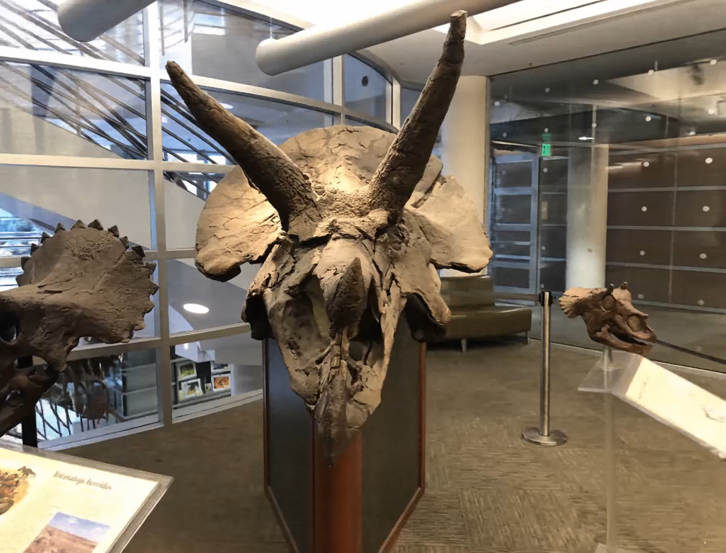
Scenes representation with NeRF

Slide 6
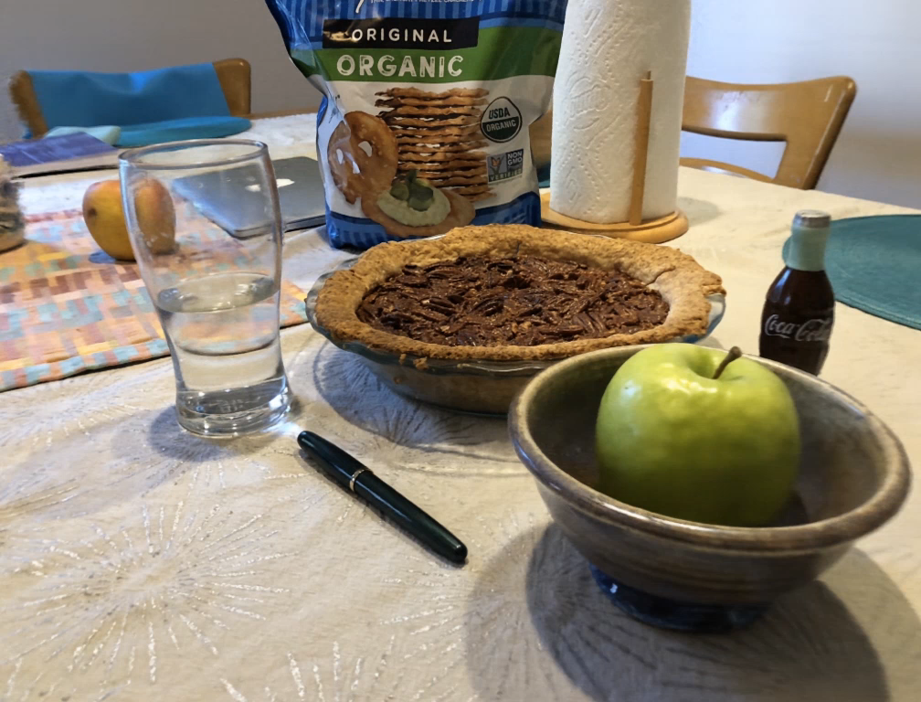
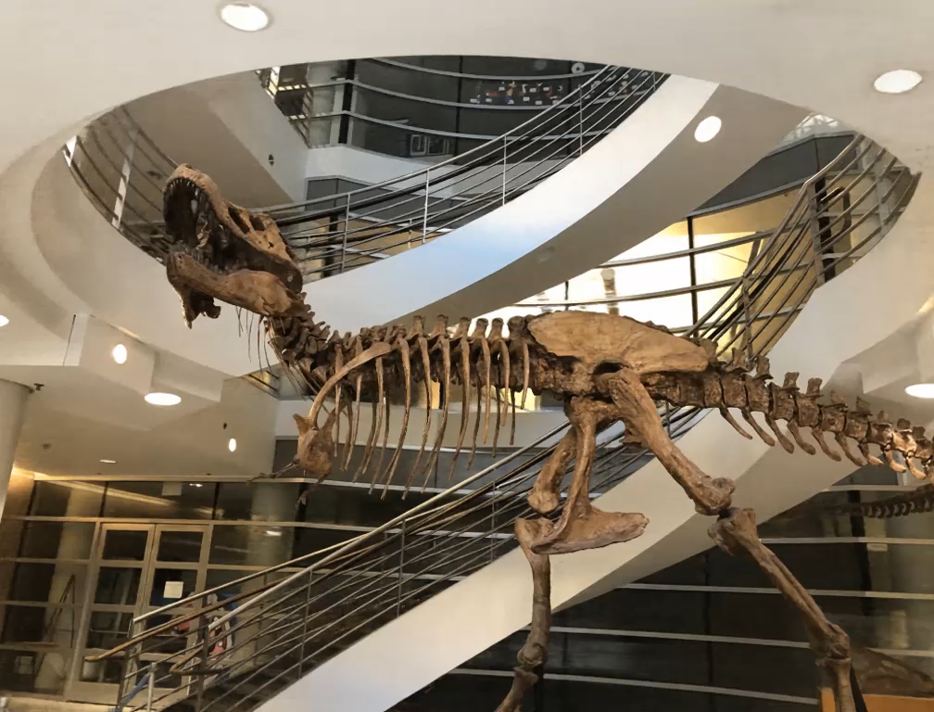
Scenes representation with NeRF

Slide 7
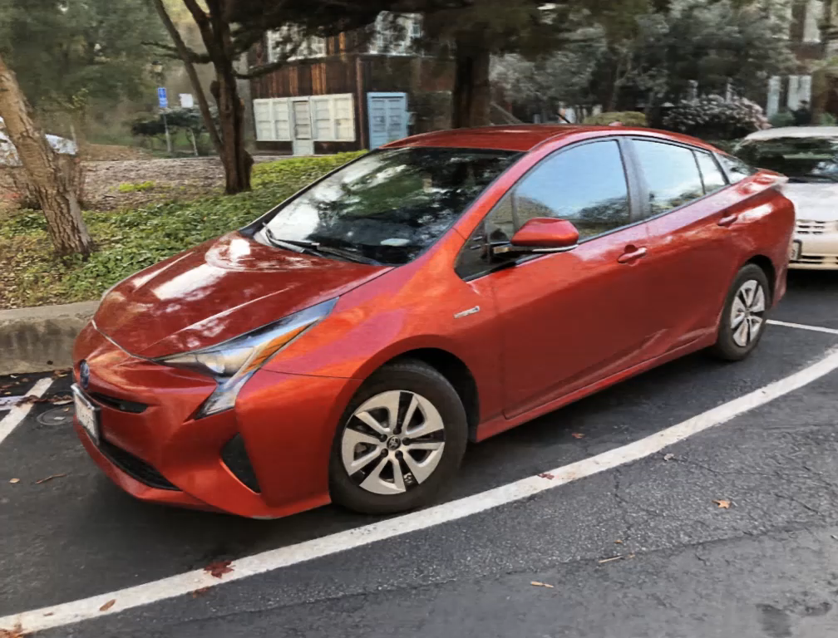
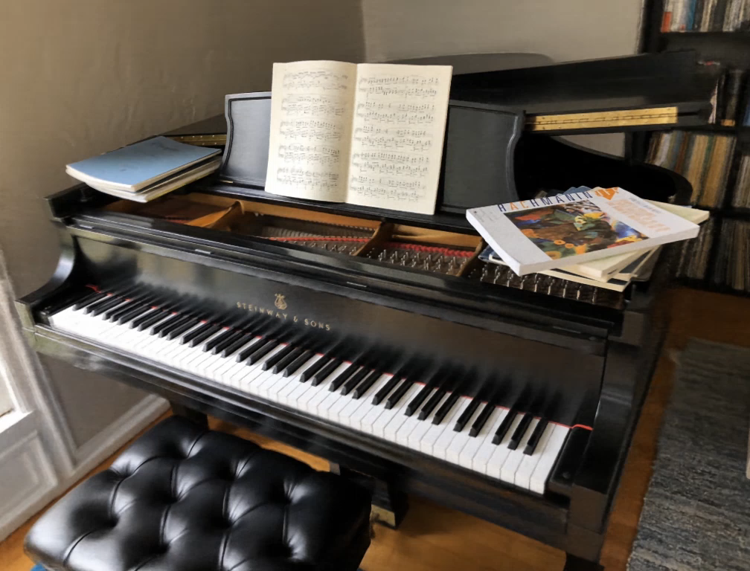
Scenes representation with NeRF

Slide 8
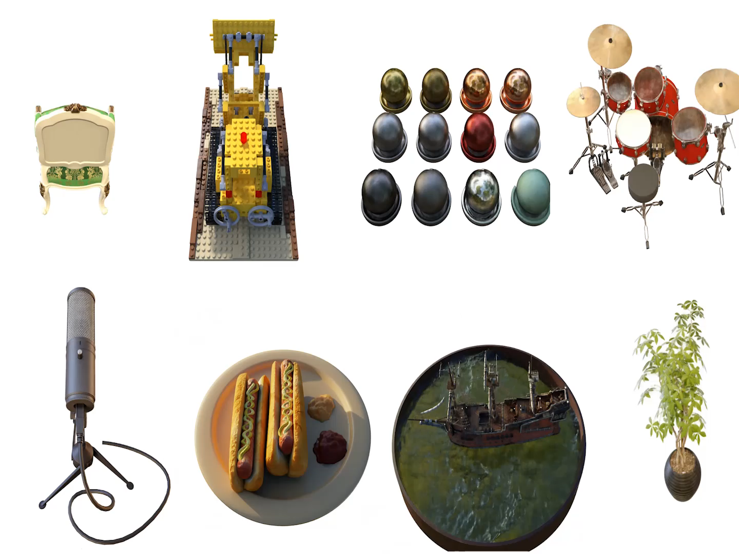
Scenes representation with NeRF

Slide 9
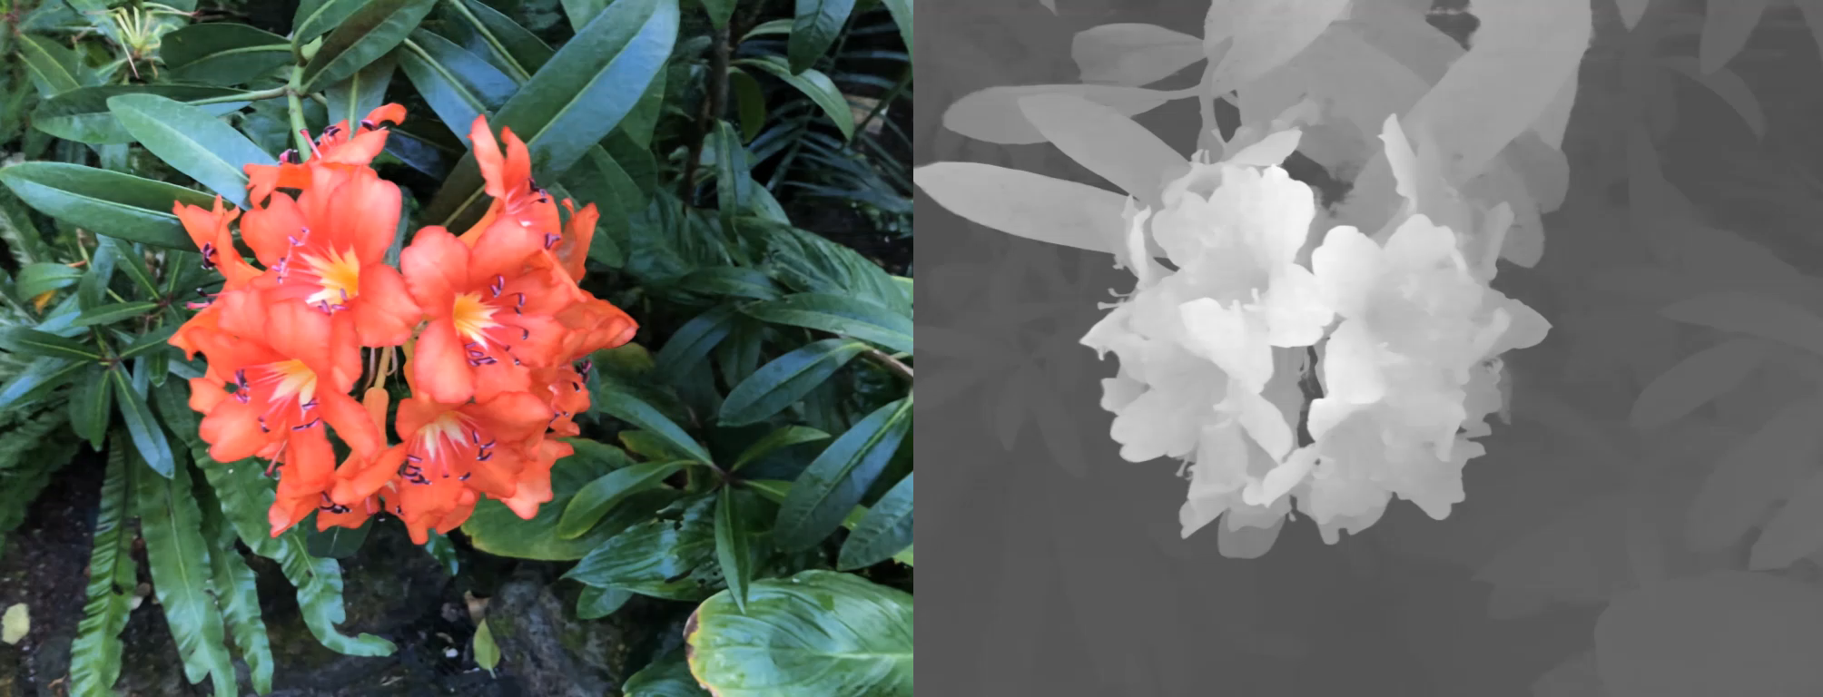
Depth maps

Slide 10
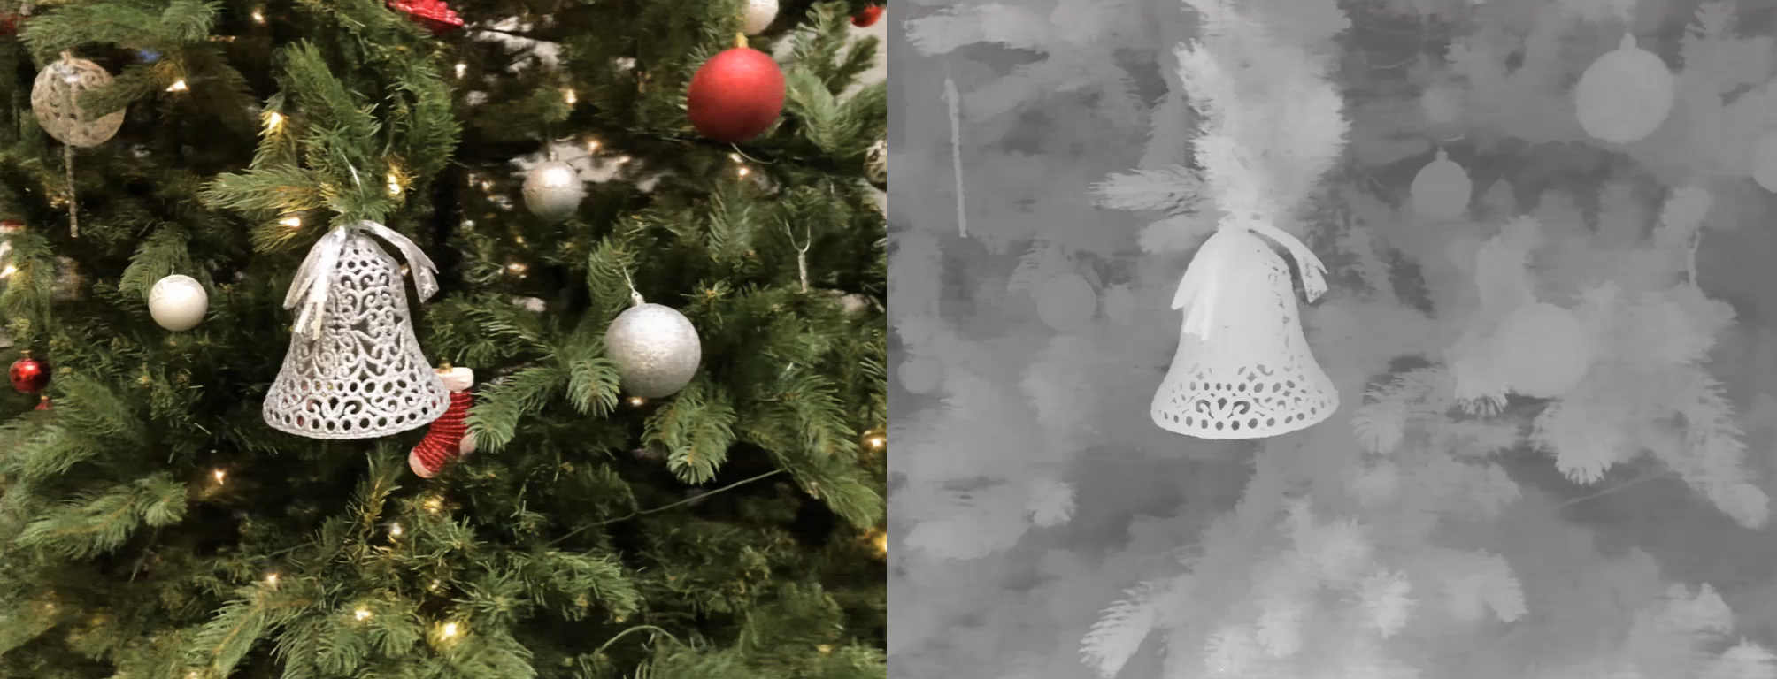
Depth maps

Slide 11
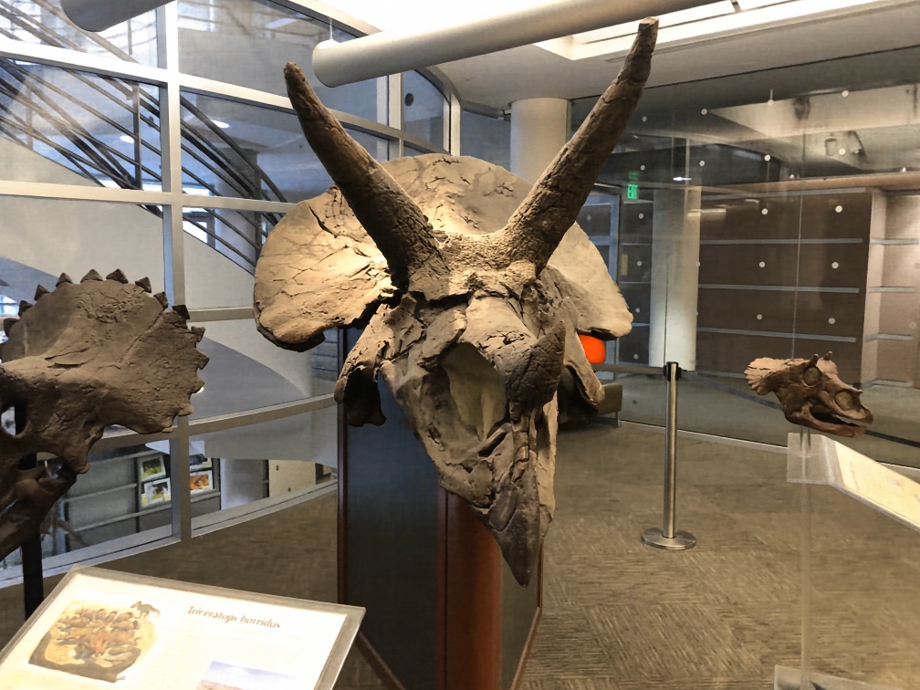
Applications

Slide 12
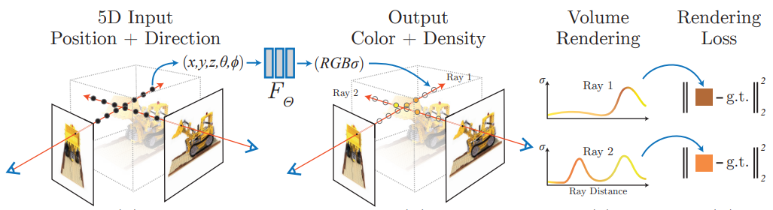
NeRF: overview

Slide 13
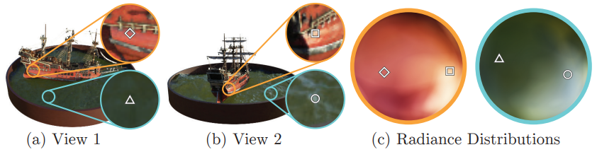
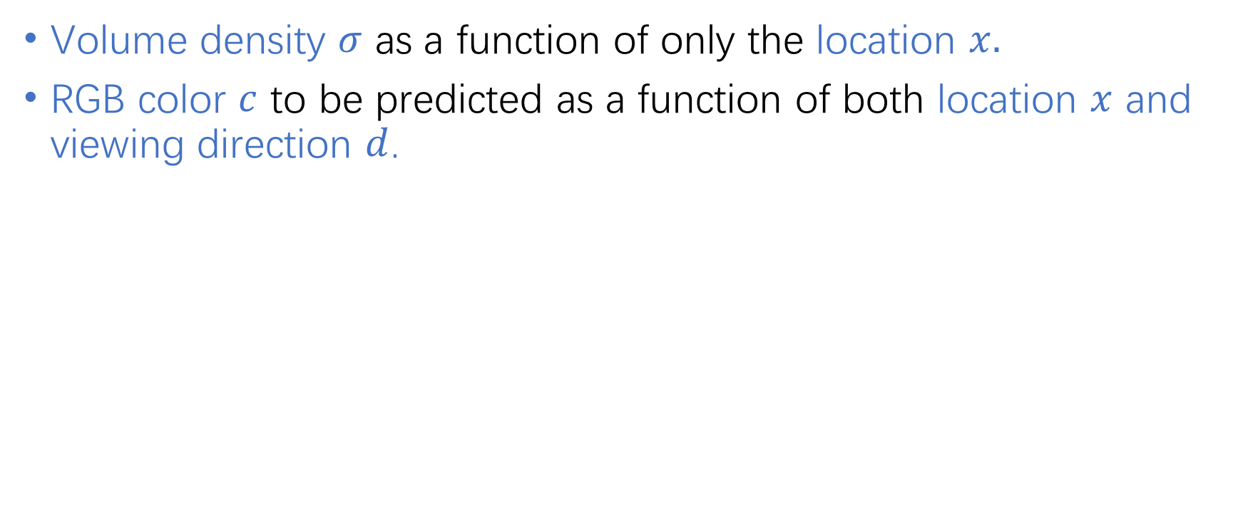
Network details
Volume density $σ$ as a function of only the location $x.$
RGB color $c$ to be predicted as a function of both location $x$ and viewing direction $d$.

Slide 14
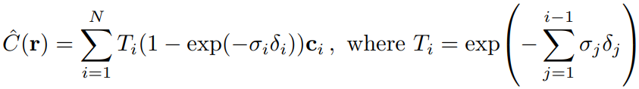
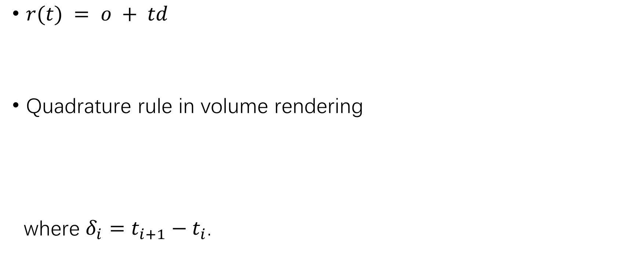
Volume Rendering
$r(t) = o + td$
Quadrature rule in volume rendering
where $δ_{i}=t_{i+1}−t_{i}$.

Slide 15
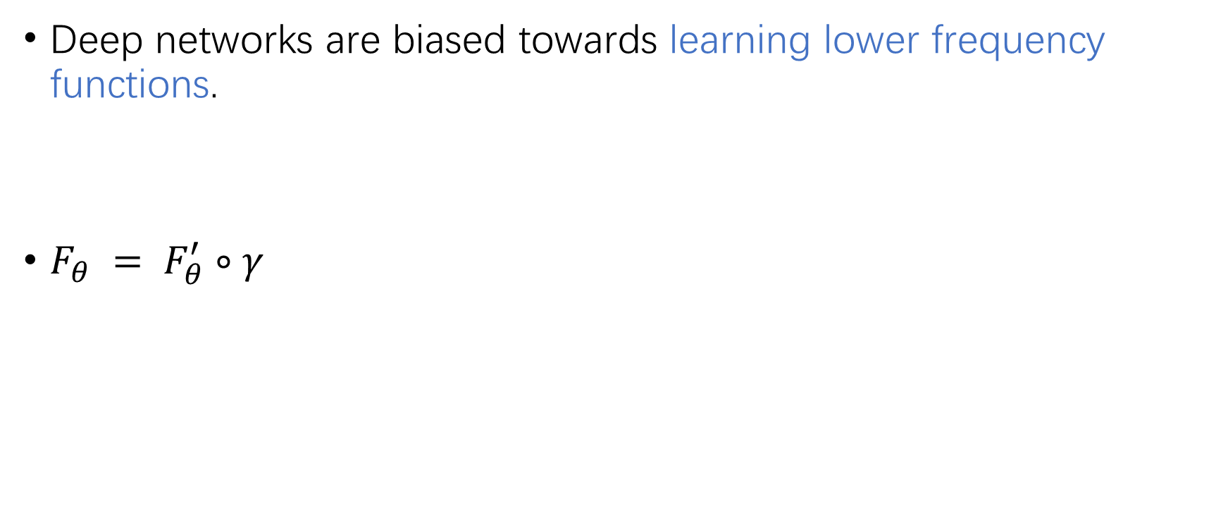
Positional encoding
Deep networks are biased towards learning lower frequency functions.
$F_{θ} = F_{θ}^{′}∘γ$

Slide 16
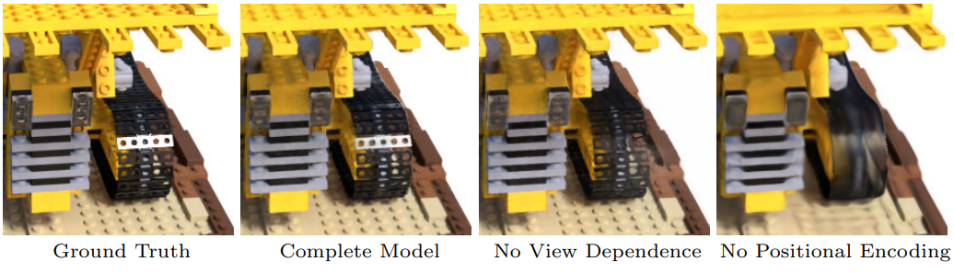
Positional encoding

Slide 17
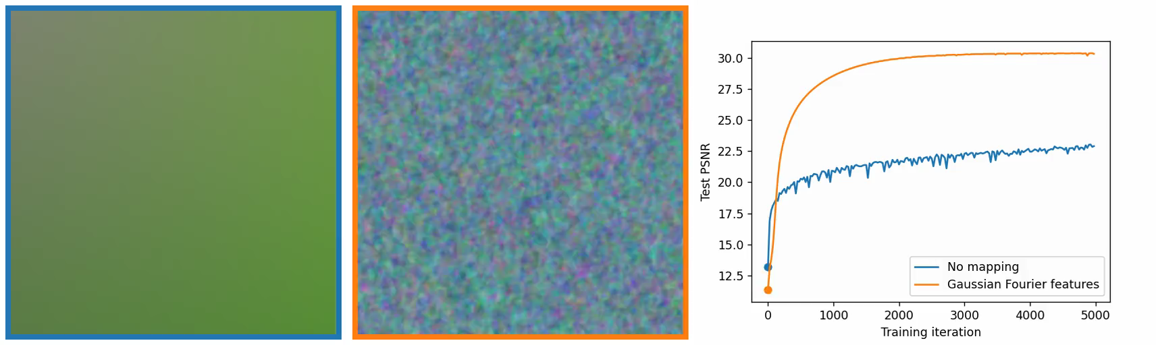
Positional encoding

Slide 18
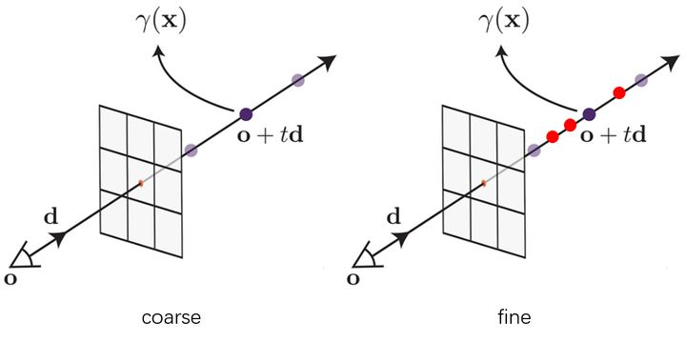
Hierarchical volume sampling
Coarse network and fine network.

Slide 19
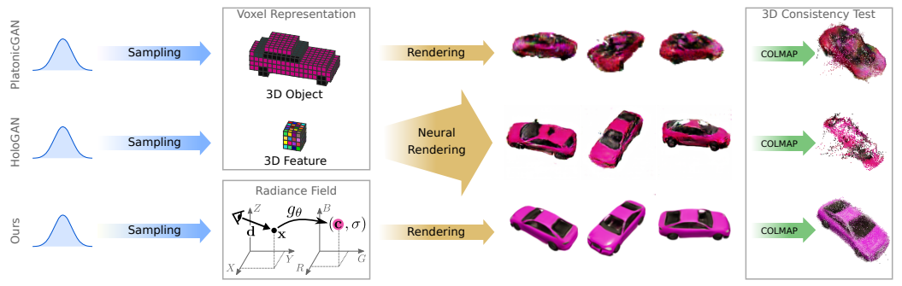
GRAF: Generative Radiance Fields
NeRF need to know the camera pose.

Slide 20
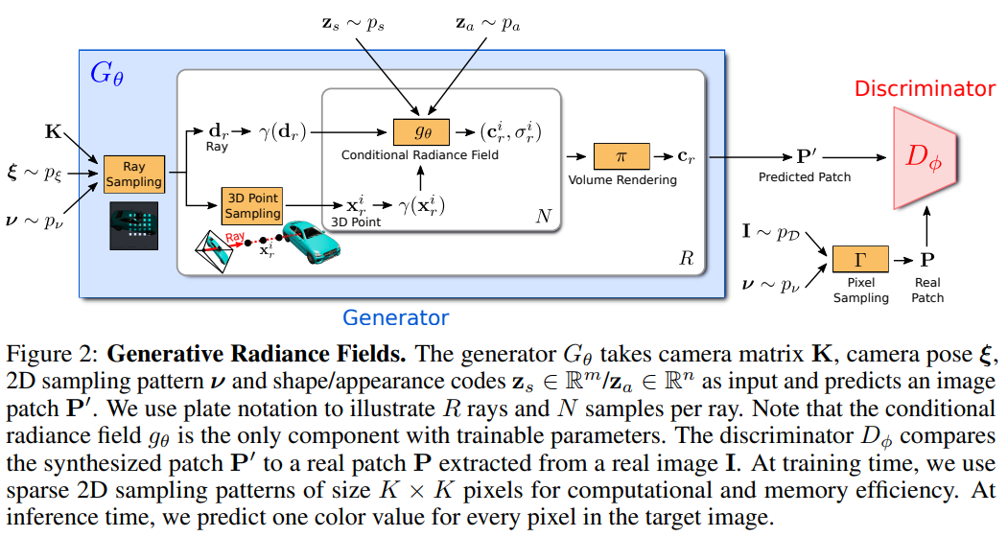
GRAF

Slide 21
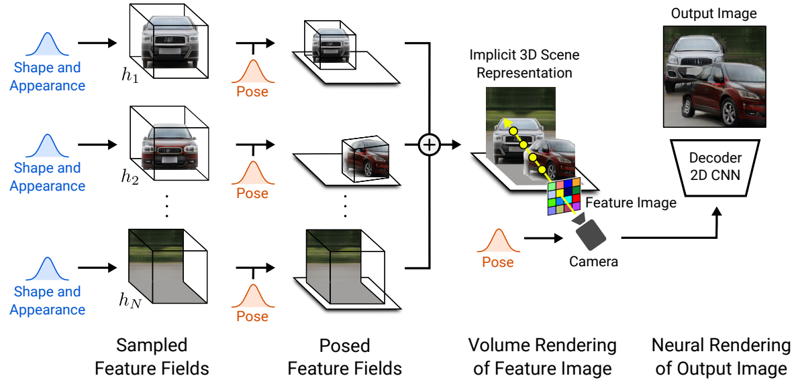
GIRAFFE: Representing Scenes as Compositional Generative Neural Feature Fields

Slide 22
From NeRF to GIRAFFE
NeRF: Representation.
GRAF: Generation.
GIRAFFE: Control.

Slide 23
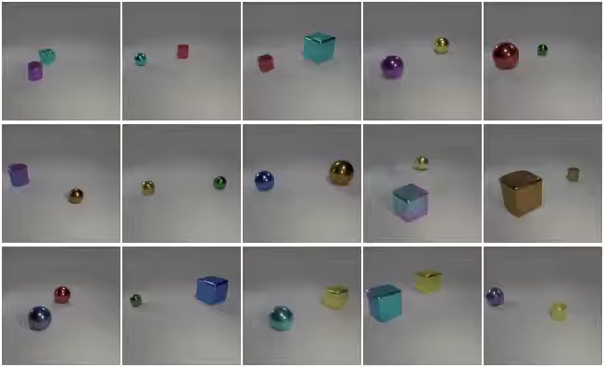
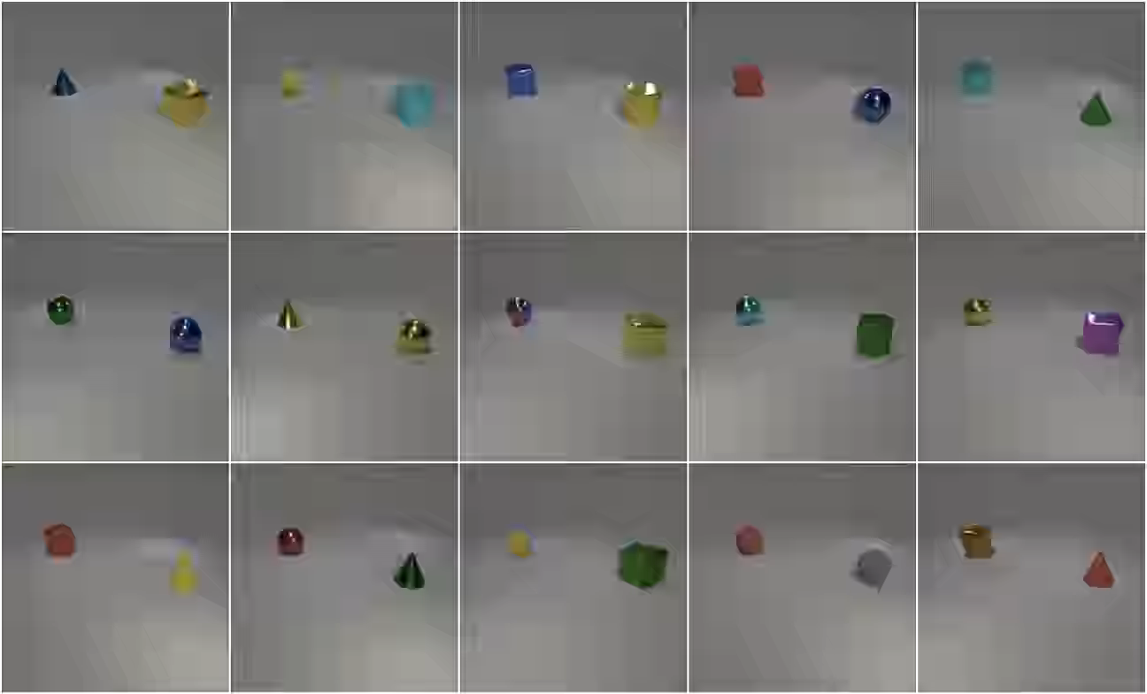
GIRAFFE
2D GAN GIRAFFE

Slide 24
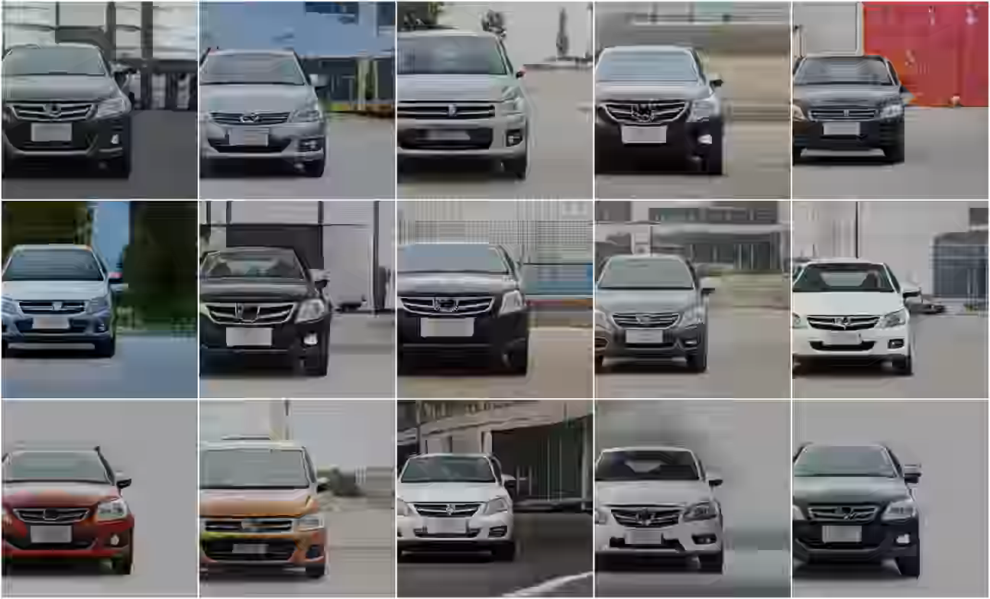
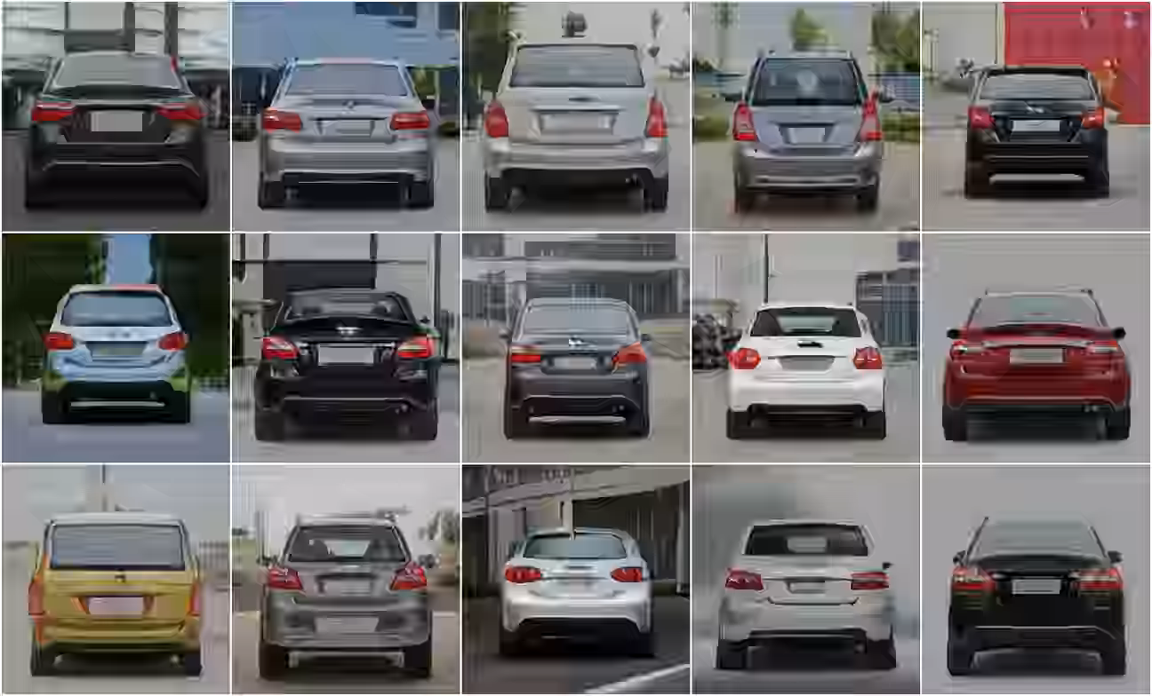
GIRAFFE
Horizontal Translation Rotate Object

Slide 25
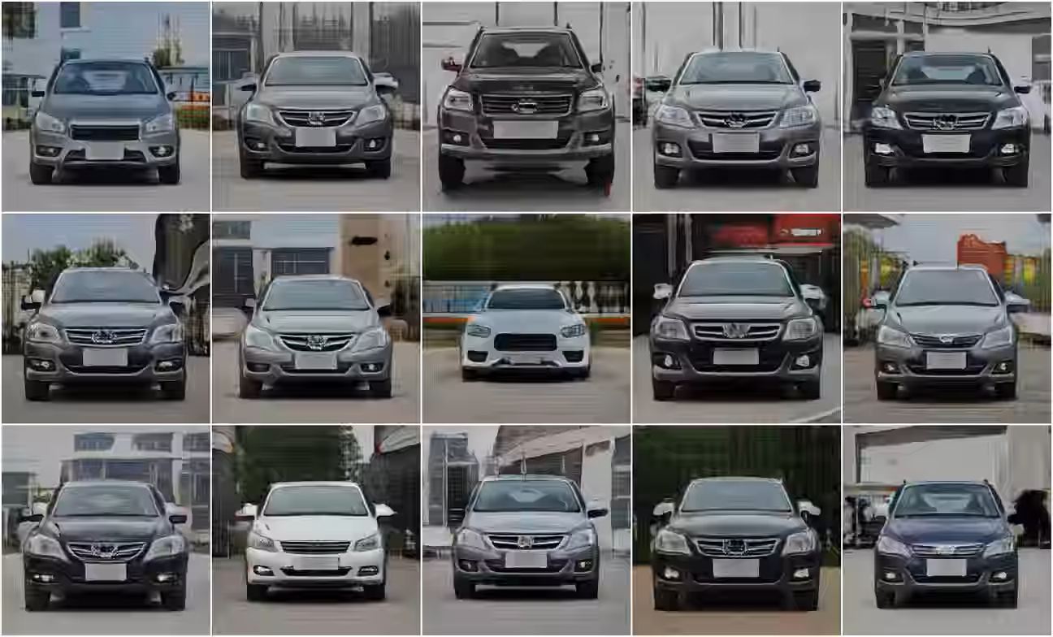
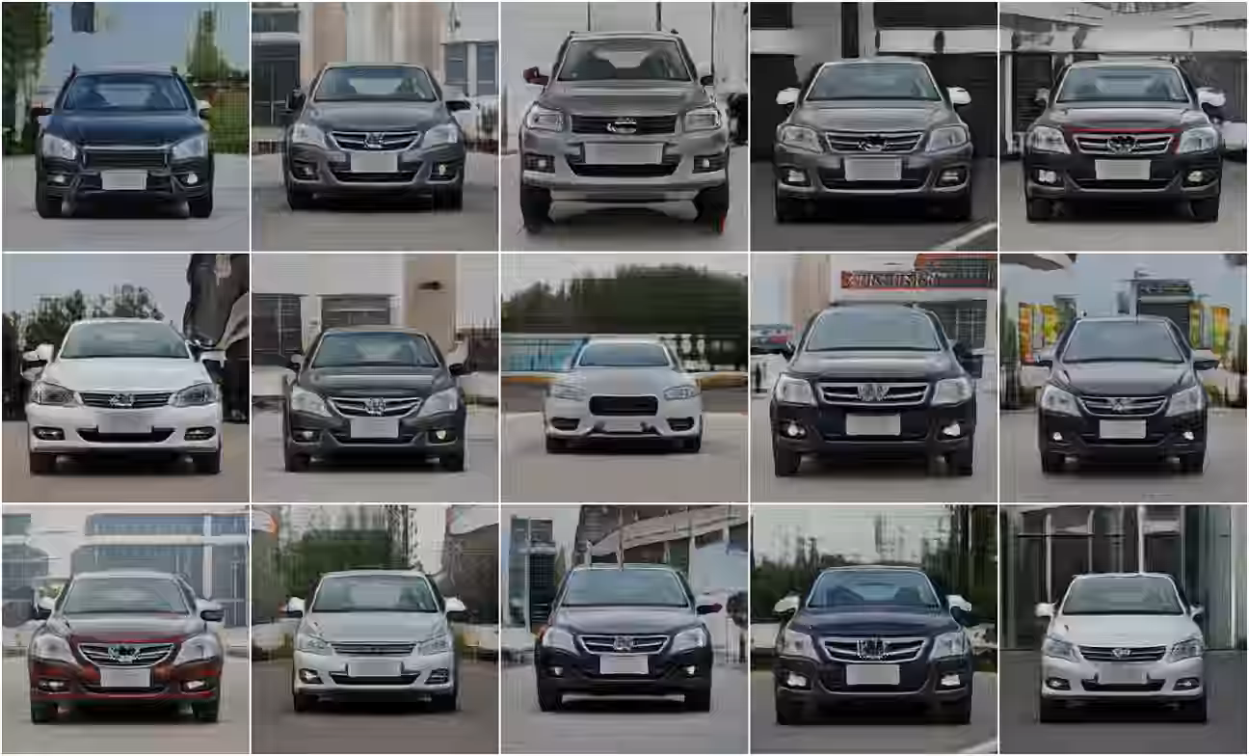
GIRAFFE
Change Object Appearance Change Background Appearance

Slide 26
Summary
NeRF: 3D scenes representation.
GRAF: 3D scenes generation.
GIRAFFE: Controllable 3D scenes representation.

